Slide 1
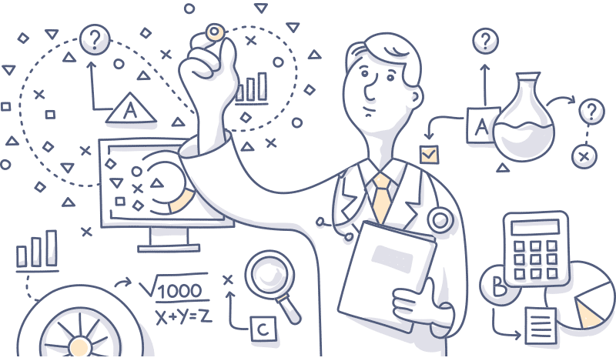
Introduction to ML
Dr. Jayaraj P. B Associate Professor Department of Computer Science & Engineering, National Institute of Technology Calicut, India

Slide 2
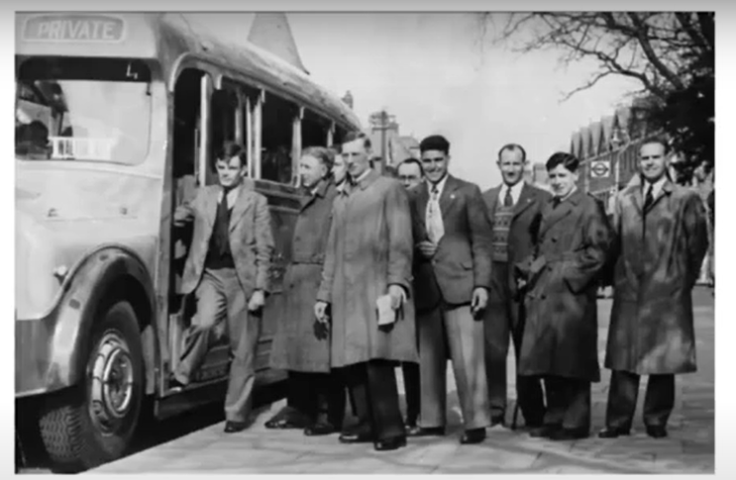
We can only see a short distance ahead, but we can see plenty there that needs to be done -Alan Turing, 1950

Slide 3
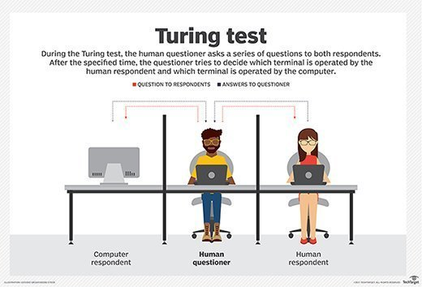
In 1950, Alan Turing introduced the Turing Test in his paper Computing Machinery and Intelligence to explore the question, “Can machines think?”
He proposed a way to answer this question through what we now call the Turing Test. This test evaluates whether a machine can mimic human responses so convincingly that a human judge cannot reliably distinguish between the two.

Slide 4
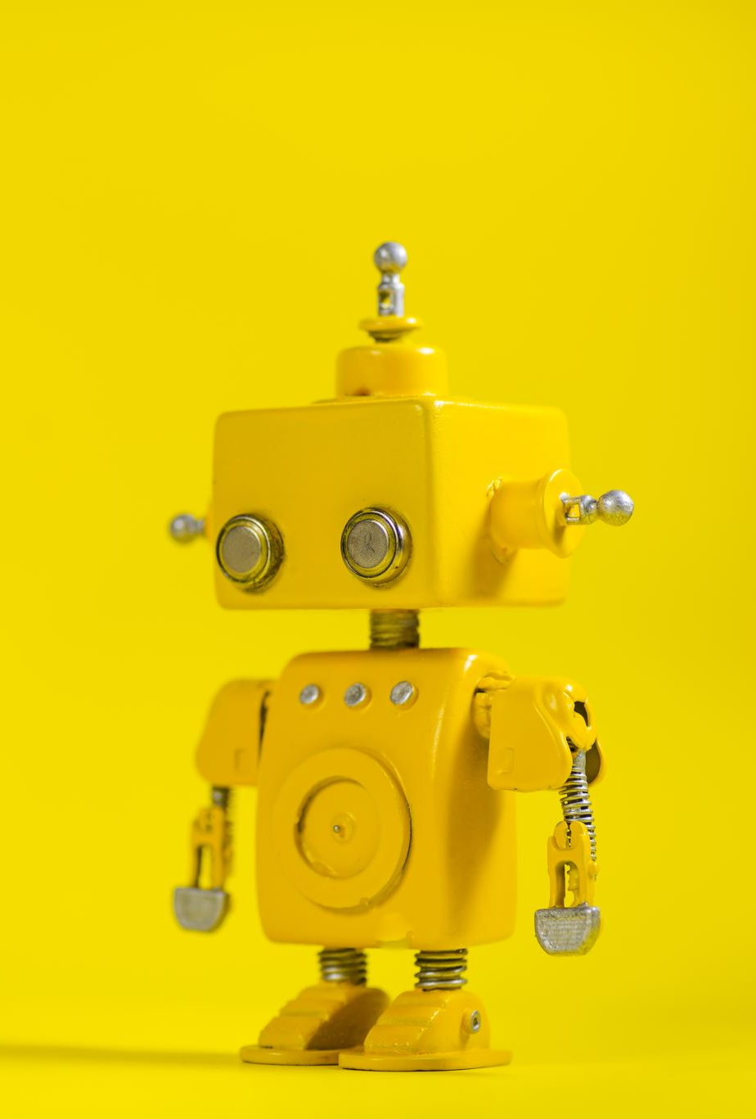
What is Artificial Intelligence ?
Artificial intelligence (AI) refers to the simulation of human intelligence in machines that are programmed to make machines to think like humans and mimic their actions.
Or Simply make Machines mimic Human Behavior or Actions

Slide 5
AI
AI is termed as ‘the new Electricity’
The main goal: To make computers more useful by letting them take over dangerous or tedious tasks from human
Computer vision – a subfield of computer science that applies mathematical techniques to understanding images and videos.

Slide 6
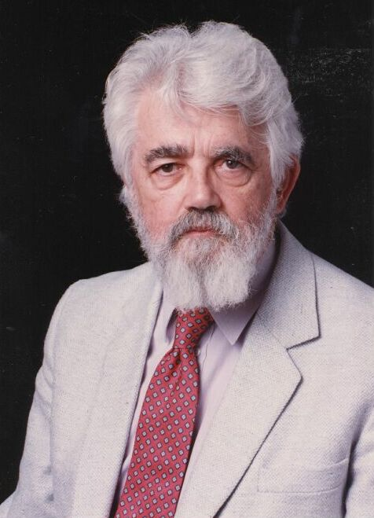
Artificial Intelligence
It is the science and engineering of making intelligent machines, especially intelligent computer programs. (John McCarthy)
The science of making machines that can perform tasks that would require intelligence if done by humans (Geffrey Hinton)

Slide 7
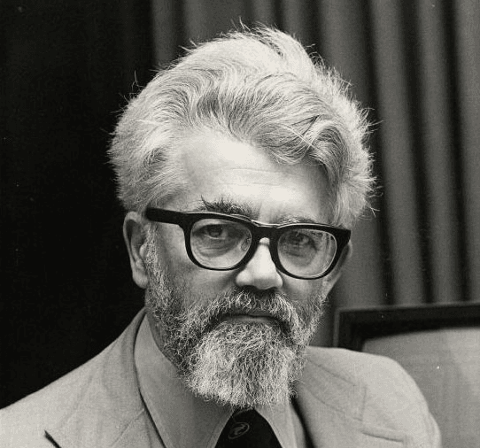
Father of AI
John McCarthy is widely regarded as the father of Artificial Intelligence. He was an American computer scientist who co-authored the document that coined the term "artificial intelligence." His work laid the foundation for the field, significantly influencing its development and direction. His contributions are central to the understanding and advancement of AI as we know it today.
He made significant contributions to the development of AI, including the invention of the Lisp programming language, which became a cornerstone for AI research
McCarthy envisioned machines that could think and reason like humans, and his work laid the foundation for many core concepts in AI.

Slide 8
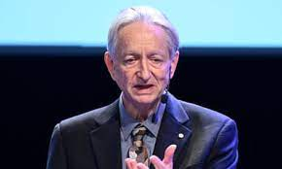
God Father of AI
Geoffrey Hinton is widely known as the "Godfather of AI" due to his groundbreaking work in the field of artificial neural networks and deep learning. His contributions have been foundational to the development of modern AI technologies.
Geoffrey Hinton Nobel Prize in Physics 2024
Born: 6 December 1947, London, United Kingdom
Prize motivation: “for foundational discoveries and inventions that enable machine learning with artificial neural networks”

Slide 9
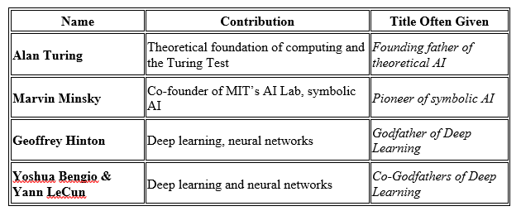
Fathers of Modern AI

Slide 10
History of AI
McCulloch and Pitts (1943)
Neural networks that learn
Minsky (1951)
Built a neural net computer
Darmouth conference (1956):
McCarthy, Minsky, Newell, Simon met,
The name “Artficial Intelligence” was coined.
1952-1969
McCarthy - Lisp (1958)
1957 - Perceptron was first used by Frank Rosenblatt
1965 – Multilevel Perceptron (MLP) was invented

Slide 11
1986-present: return to neural networks
Back Propagation algorithm was found
1989 – Convolutional Neural Networks (CNN) were found
1991 – Recurrent Neural Networks (RNN)
1997 – LSTM (Long Short Term Memory)
2007 – GPUs and CUDA frameworks were invented
2012 – Adam Optimizer
2014 – Ian Goodfellow invented the GAN network
2016 – Pascal GPUs (with unified memory) were released
2017 – Transformers were invented
2022 - ChatGPT

Slide 12
The Birthplace of “Artificial Intelligence”, 1956
Dartmouth workshop, 1956: historical meeting of the perceived founders of AI met: John McCarthy, Marvin Minsky, Alan Newell, and Herbert Simon.
A Proposal for the Dartmouth Summer Research Project on Artificial Intelligence.
"We propose that a 2 month, 10 man study of artificial intelligence be carried out during the summer of 1956 at Dartmouth College in Hanover, New Hampshire. The study is to proceed on the basis of the conjecture that every aspect of learning or any other feature of intelligence can in principle be so precisely described that a machine can be made to simulate it." And this marks the debut of the term "artificial intelligence.“

Slide 13
What is Learning?
13
Herbert Simon: “Learning is any process by which a system improves performance from experience.”
“A computer program is said to learn from experience E with respect to some class of tasks T and performance measure P, if its performance at tasks in T, as measured by P, improves with experience E.”
– Tom Mitchell
Notes:
13

Slide 14

How Do Children Learn?
- Expose them to lots of data
- Give them the “correct answer”
- They will pick up the important
patterns on their own
Notes:
With children, we expose them to lots of data, and help them learn by supplying the correct answer. A very popular learning technique is “Trail and Error”, where students make a prediction on what is the correct answer, and if they’re wrong, adjust their approach. It turns out that deep learning is very much like this.

Slide 15
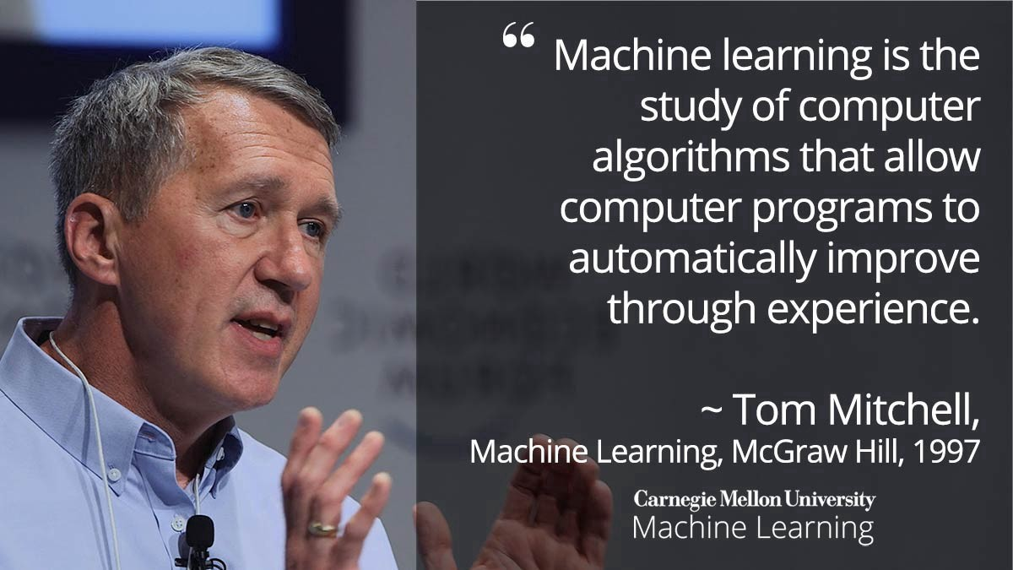
Machine Learning

Slide 16
Supervised vs Unsupervised Machine Learning
When the data we have is labelled and use it to train a ML model it is called supervised machine learning
Examples
Classification Problems
You have 1000s of labelled images of cats and dogs and train a ML model to classify a new image as cat or dog
When the data we have is unlabeled and use it to train a ML model it is called unsupervised machine learning
Examples
Clustering Problems
You have a data of customers and want to segment them into groups but don’t know which criteria to select, a clustering model can help cluster your customers into segments.

Slide 17
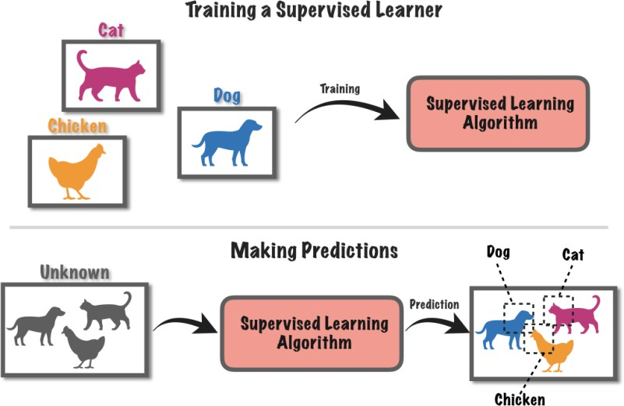
Supervised Learning
Figure: Supervised Learning (Source: TowardsDataScience.com)

Slide 18
Typical Training process of a ML Model

Slide 19
Train – test splitting

Slide 20
Anatomy of Supervised Learning Algorithm
Optimization Algo
input
Model
Prediction
Dataset
expected output
Loss Function
Loss

Slide 21
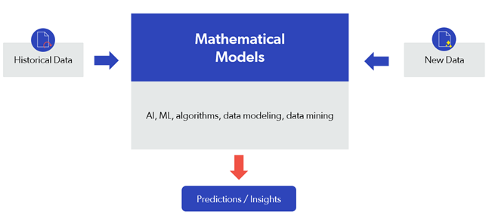
Predictive AI Vs Generative AI
Predictive AI uses statistical algorithms and Machine Learning to forecast trends, behavior, patterns, and predictions from large data sources.

Slide 22
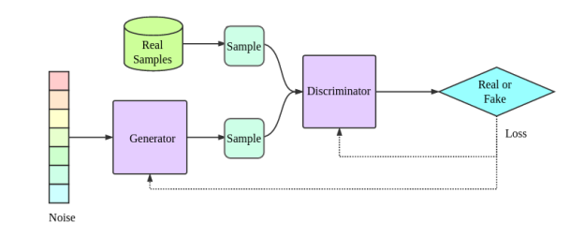
Generative AI
Generative AI is an advanced form of ML that generates new content from scratch. It takes raw data and creates something novel but also recognizable

Slide 23
Areas of AI and Some Dependencies
Knowledge Representation
Search
Logic
Machine Learning
Planning
Expert Systems
NLP
Vision
Robotics

Slide 24
Linear Regression
Linear Regression is a method in statistics used to predict the value of a variable based on another variable.
Linear regression focuses on the linear dependence of variables.
Graphically, given a set of points the aim of linear regression is to find the line that best fits the points.

Slide 25
Problem Definition
Consider the problem of house price prediction.
Let the price of a house (R), depend on only one factor the number of rooms (A)
The input dataset contains (number of rooms, price of house)
The task is to predict the price of a house for a given input of number of rooms.
Number of Rooms (A) | Price of House (R)
1 | 20
2 | 30
3 | 40

Slide 26
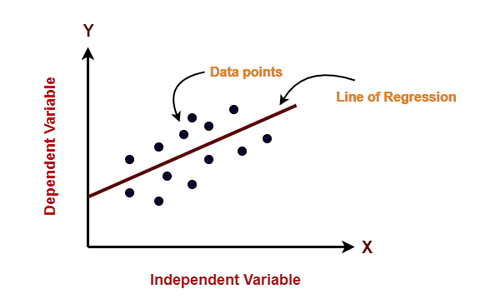
Linear Regression
Linear regression model represents the linear relationship between a dependent variable and independent variable(s) via a sloped straight line.

Slide 27
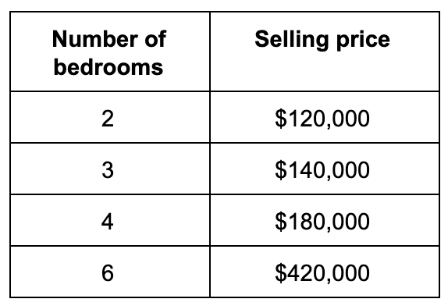
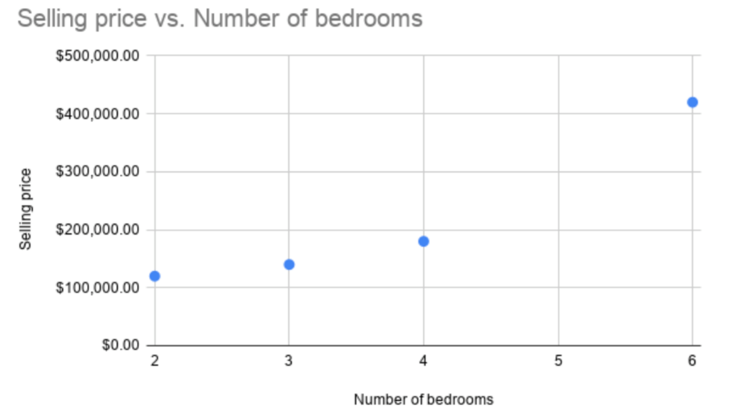

Slide 28
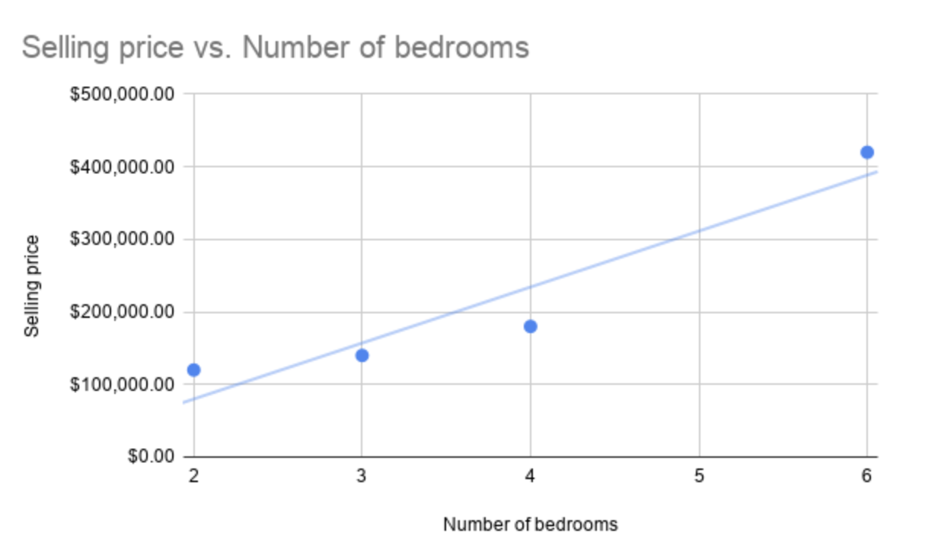
This model assumes a linear relationship between the dependent variable and the predictor variable

Slide 29
Training the Linear Regression
We train the linear regression algorithm with a method named Mean Squared Error (MSE). The goal of training is to find the weights w_{i} in the linear equation Y = WX + B
This has four main steps in machine learning:
1. Random weight initialization. In practice, w₀ and w₁ are unknown at the beginning. The goal of the procedure is to find the appropriate values for these model parameters. To start the process, we set the values of the weights at random.
2. Input the initialized weights into the linear equation and generate a prediction for each observation point. To continue with the example that we’ve already used:

Slide 30

Gradient Descent

Slide 31
Training the Linear Regression
Gradient Descent
input
R = αA + β
Prediction
(No of rooms, price)
expected output
Loss
MSE = ¹ (y − y
₎2
2
pred expected

Slide 32
Logistic Regression
In the Linear regression model used to make predictions for continuous variables (numeric variable).
Logistic regression is a classification model. It will help you make predictions in cases where the output is a categorical variable.
Logistic regression is easy to of all classification models.
It is very common to use interpretable various industries such as banking, healthcare, etc.

Slide 33
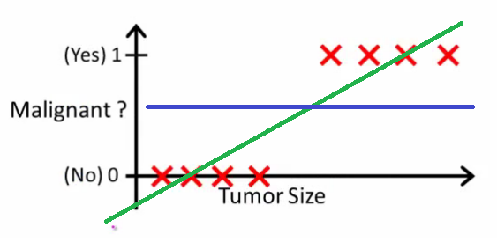
Why do we use Logistic Regression rather than Linear Regression for classification?
After reading the definition of logistic regression we now know that it is only used when our dependent variable is binary and in linear regression this dependent variable is continuous.

Slide 34
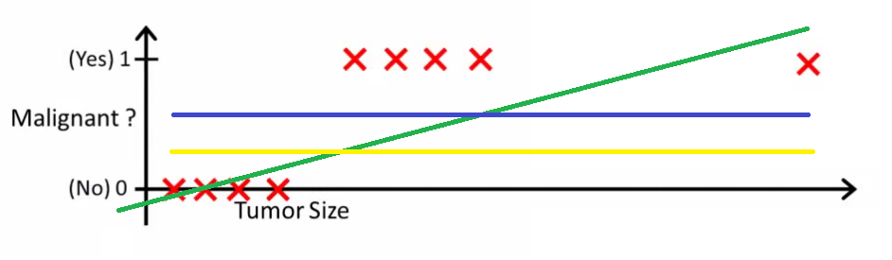
The second problem is that if we add an outlier in our dataset, the best fit line in linear regression shifts to fit that point.

Slide 35

Another problem with linear regression is that the predicted values may be out of range. We know that probability can be between 0 and 1, but if we use linear regression this probability may exceed 1 or go below 0.
Hence, we apply sigmoid function to squeeze the output between 0 to 1. Sigmoid squeezes a straight line into an S-curve.

Slide 36
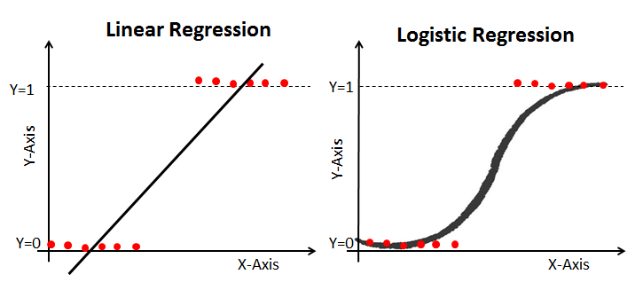
Cost Function in Logistic Regression ?
This is our logistic function, also called a sigmoid function. It squeezes a straight line into an S-curve.

Slide 37

Log Loss (BCE Loss)
In order to solve this problem, we derive a different cost function for logistic regression called log loss (BCE Loss) which is also derived from the maximum likelihood estimation method.

Slide 38
Artificial Neuron
Mathematical construct mimicking real neurons
Each neuron takes in a set of inputs, each input has a certain amount of importance. These inputs along with their importances are combined to produce an output for the neuron.
b
x₁
w₁
w₂
x₂
Z = F ( Σw_{i}x_{i} + b )
Z
w₃
x₃
w₄
x₄

Slide 39
Artificial Neural Network
Putting artificial neurons together to create an artificial brain
A set of neurons are organized in a layer, each network consists of multiple layers of these neurons. Each neuron of a layer is connected with each neuron of the adjacent layer. Hence the outputs of all neurons in a layer are passed as input to the next layer.

Slide 40
But how does this learn?
Training an ANN
We pass the ANN an input, initially it produces a random output. We inform the model that the output is wrong. It goes back and tweaks the ‘importance’ it gives to every input and this results in a slightly better result. The model is again informed of its errors and the process continues till it reaches the desired performance level.
ANN Model
INPUT
OUTPUT
modify importances
ERROR
compare with correct output

Slide 41
An example of a learning pass
Open House on AI for HealthCare

Slide 42
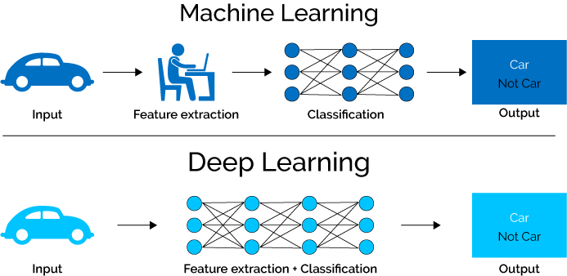

Slide 43

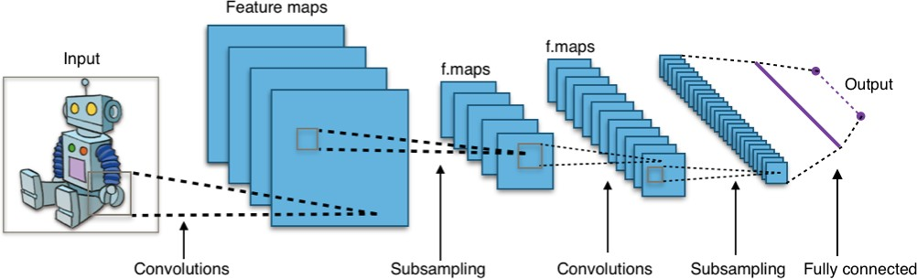
History of CNN
In 1995, Yann introduced the concept of convolutional neural networks.

Slide 44
Convolution Neural Networks
Limitation of conventional ANNs
The standard ANN in itself can only work with small images hence we use an alteration called a convolutional neural network (CNN) which takes an image as input and converts it into a smaller image by encoding each pixel with its neighbouring context.
Importance of CNNs
CNNs allow us to process images faster with lesser compute. They have been used to create numerous models for various image related tasks.

Slide 45
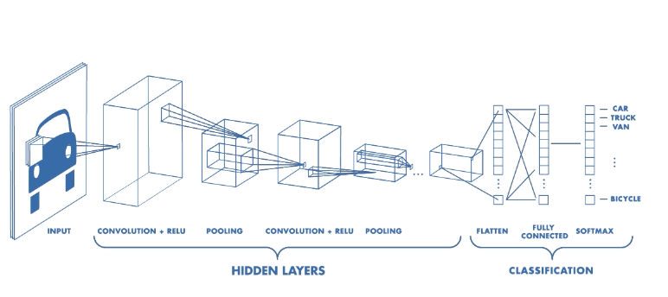
Typical Structure of a CNN

